Slide 1
Evolutionary strategies (ES)
Litvinov Andrei 1820249042
Baryshev Maksim 1820249043
Medvedev Ivan 1820249044

Slide 2
Table of Contents
1
2
3
4
5
6
7
8
9
Introduction to ES
Fundamental Concepts of ES
Mathematical Foundations
Algorithm Workflow
Implementation Examples
Applications in ML
Pros & Cons
Real-world cases
Future trends

Slide 3
Introduction to Evolutionary strategies
1

Slide 4
What Are Evolutionary Strategies?
Definition
Core idea
Inspired by how species evolve over generations to adapt and survive.
ES are a type of optimization algorithm that mimics the process of natural evolution.

Slide 5
Historical background
1
2
3
Origins
Purpose
Legacy
Developed in the 1960s by German researchers.
Created to solve problems that were difficult to tackle with traditional methods.
Pioneered modern evolutionary algorithms and laid the groundwork for future.

Slide 6
2
Fundamental Concepts of ES

Slide 7

Population and Individuals
Population
Individual
Simply a group of possible solutions to the problem you are trying to solve.
One possible solution explores different parts of the search space.

Slide 8
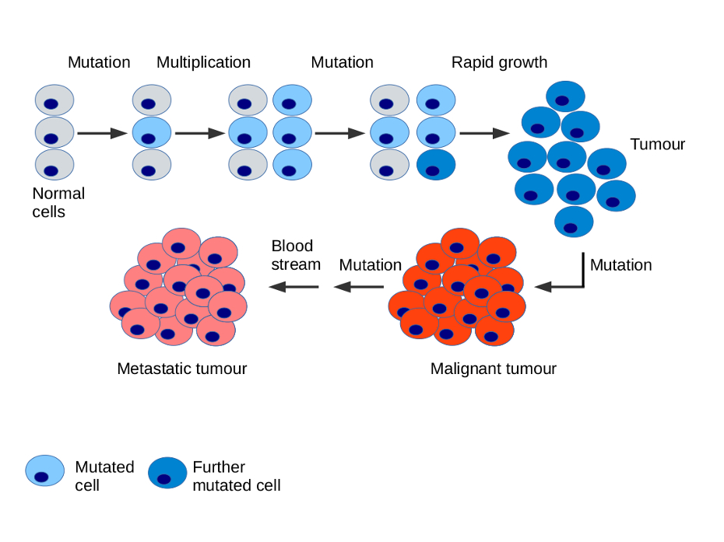
Mutation and Recombination
Mutation
Recombination
Small random changes to the individuals, helping them "jump" to new solutions and avoid getting stuck in one place.
Solutions are combined to create new ones, can be used to share good traits between solutions.

Slide 9

Selection Mechanisms
Process determines which individuals get to continue to the next round. In some cases, only the new solutions (offspring) are considered, ensuring fresh ideas for every generation.

Slide 10

Fitness Evaluation
Fitness tells us how close each individual is to solving the problem.
The best solutions are more likely to survive and influence the next generation.

Slide 11
Mathematical Foundations
3

Slide 12

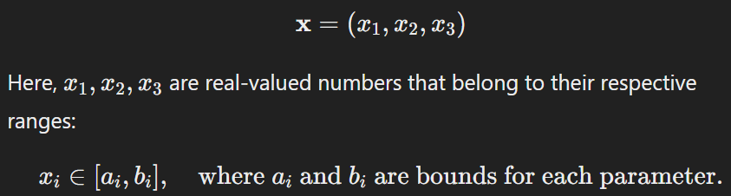
Representation of Solutions
Mathematical Model of Solutions
In ES, each solution is typically represented as a vector of real numbers, which corresponds to the parameters of the problem.
Dimensionality
The dimension n of the vector {x} depends on the number of variables in the optimization problem.

Slide 13
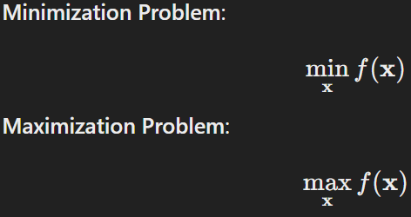
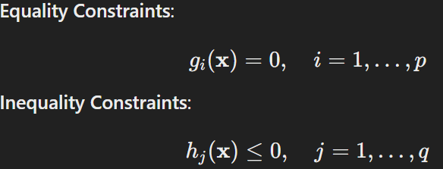
Objective Function and Optimization
Objective function
Constraints
Performance metrics
The objective function, denoted as f(x), is a mathematical expression that evaluates how "good" a solution is.
Optimization problems often include constraints that limit the values the solution vector can take.
The choice of the function depends on the specific problem:
In engineering might measure the weight, cost, or energy efficiency.
In ML could represent the error.

Slide 14

Strategy Parameters in ES
Step Size (σ)
Mutation of Step Size
Controls the size of random changes (mutations) applied to solutions.
Step size adapts based on performance, ensuring flexibility during the search.
Self-Adaptive Parameters
Advantages
Step sizes evolve along with solutions to balance exploration and exploitation.
Dynamically adjusts mutation rates, reducing the need for manual tuning.

Slide 15

Algorithm Workflow
4

Slide 16
Initialization of Population
What it is
How it’s done
Importance of Diversity
Improving the chances of finding good solutions.
If diversity is low, the algorithm risks converging prematurely to suboptimal.
The first step (ES) is creating an initial population of candidate solutions.
Solutions are typically generated randomly within the bounds of the problem's variables.

Slide 17
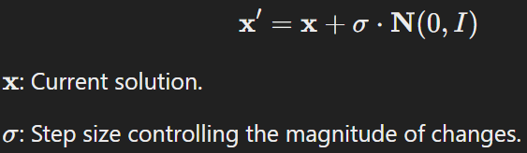
Project Timeline
Mutation
Selection
Chooses which individuals will form the next generation.
Common strategies:
(μ, λ) or (μ + λ)
Introducing random changes to individuals in the population.
Evaluation
Reproduction
Selected individuals are used to generate the next population, may include recombination.
Each mutated individual is evaluated using the objective function f(x)

Slide 18
Convergence Criteria
Maximum Generations
Solution Quality
The algorithm halts after a fixed number of generations.
The algorithm stops when a solution achieves a predefined target fitness value.
Minimal Improvement
Diversity Threshold
If the improvement in the objective function value becomes negligible, the algorithm assumes convergence.
If the population becomes too similar, the algorithm might stop.

Slide 19
ES vs Genetic Algorithms (GAs)
Primary Operators
Selection Mechanism
Representation
Self-Adaptation
ES: real-valued vectors.
GAs: binary strings
ES: dynamic tuning of the mutation rate.
GAs: fixed mutation and crossover rates.
ES: mutation.
GAs: crossover (recombination).
ES: (μ, λ) or (μ + λ) selection strategies.
GAs: more complex selection schemes.

Slide 20

Implementation Examples
5

Slide 21
Variants of Evolutionary Strategies
A
C
To Optimize a Function
Implementation of (μ+λ)
Uses ES to find the min or max of a mathematical function.
Selects the best μ individuals from the combined pool of μ parents and λ offspring.
A
?
B
B
D
For Neural Network Optimization
Implementation of (μ, λ)
C
D
Apply ES to optimize neural network parameters (e.g., weights and biases).
Selects the best μ individuals from only the λ offspring, discarding all parents.

Slide 22
Key Parameters and Their Impact
Generations (`num_generations`)
Parents (`num_parents`)
More generations allow deeper search but increase runtime.
Affects genetic diversity; too many dilute elite traits.
Population Size (`population_size`)
Mutation Strength (`sigma`)
Larger sizes promote diversity and avoid local optima.
Controls exploration; high `sigma` explores more, low `sigma` fine-tunes.

Slide 23
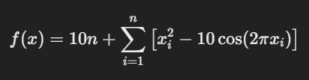
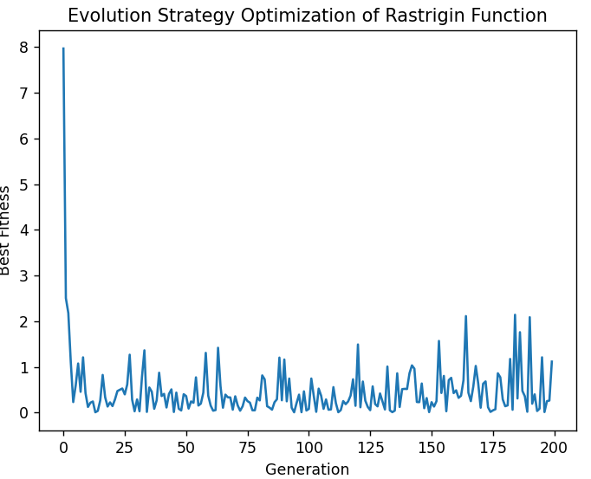
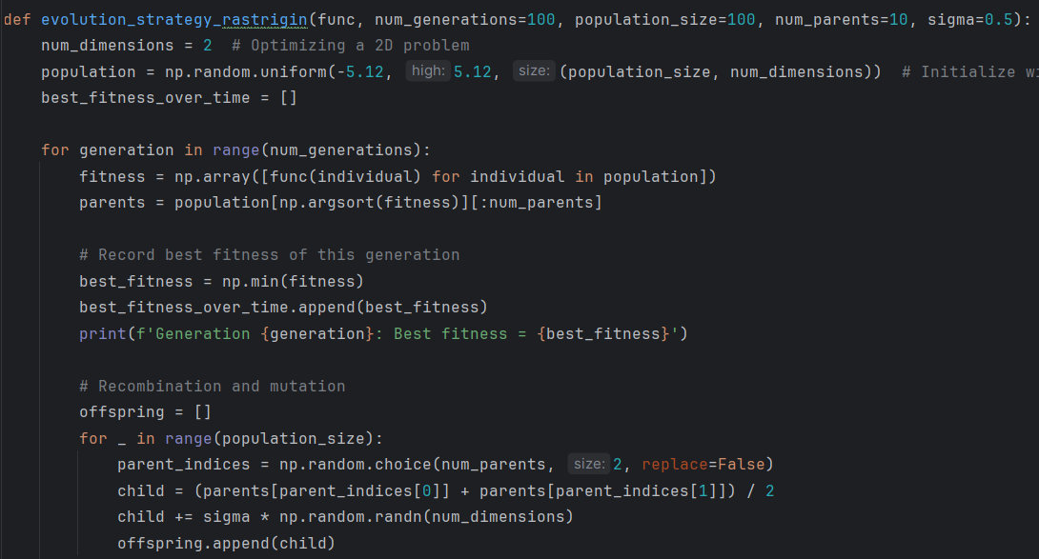
Concept of Minimization in ES
The Rastrigin function is a non-convex function with multiple local min.
Shows the trend of best fitness values across generations. A downward trend indicates the optimization is effectively minimizing the function.

Slide 24
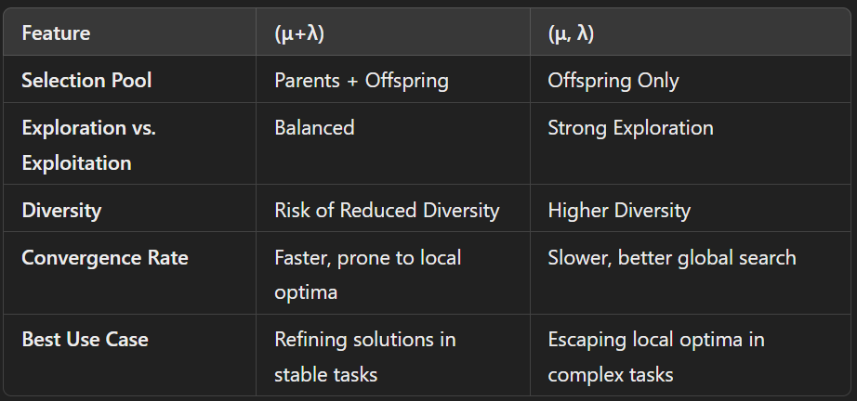
Differences Between (μ+λ) and (μ, λ)

Slide 25
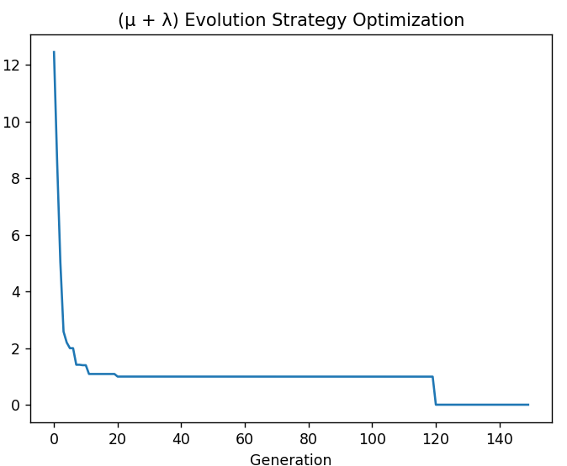
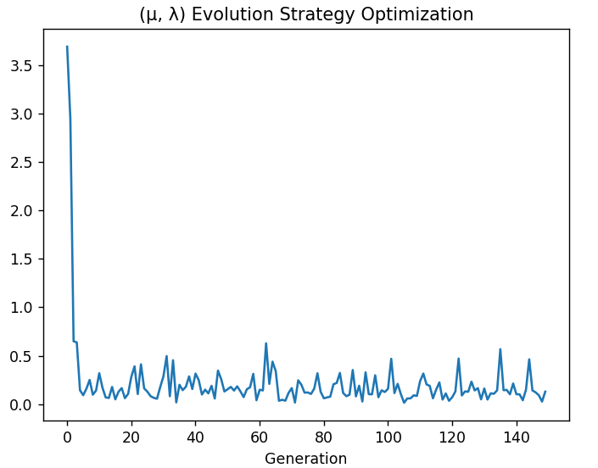
Differences Between (μ+λ) and (μ, λ)
Similar to the simple strategy, it plots the best fitness values over time. An effective (μ + λ) strategy will show a consistent improvement in fitness, reflecting how well the strategy balances exploration and exploitation.
In a (μ, λ) strategy, the fitness plot illustrates the best fitness values over generations. Unlike (μ + λ), the improvement may initially appear slower due to the reliance on entirely new offspring in each generation.

Slide 26
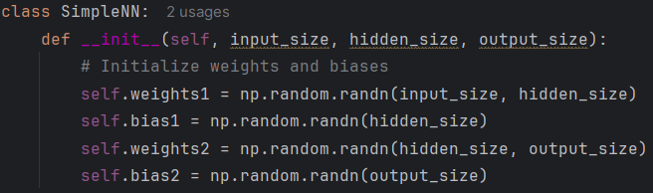
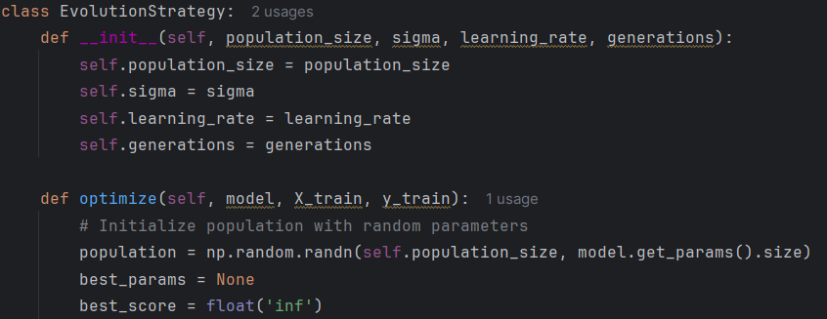
Neural Network Optimization
We start by initializing the neural network with random weights and biases.
Synthetic data is ideal for training because it has a simple underlying relationship that the network can learn.

Slide 27
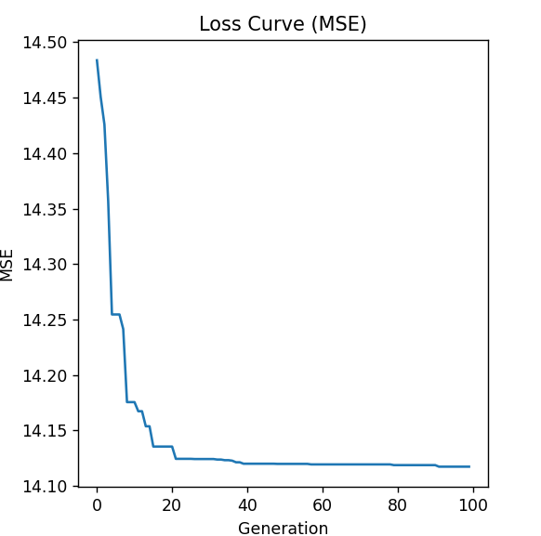
NN Optimization (visualization)
This plot shows how the best MSE (Mean Squared Error) evolves over generations
The x-axis shows the generation number.
The y-axis represents the MSE loss, which should ideally decrease over time as the model improves.
The loss curve should show a decrease in MSE, indicating that the model is improving over time.

Slide 28

Applications in Machine Learning
6

Slide 29
Popularity of applications
40%
Reinforcement Learning (RL)
25%
Automated Machine Learning (AutoML)
20%
Meta-Learning
15%
Robustness Testing and Adversarial Learning

Slide 30
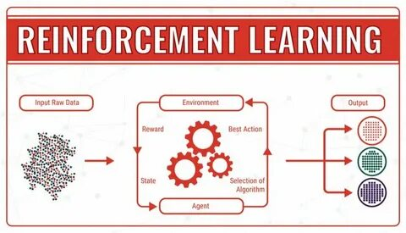
Rainforcement learning (RL)
Robust Learning: ES can handle noisy reward signals, a common challenge in RL, due to its population-based evaluation.
Policy Optimization: ES directly optimizes policies represented as parameter vectors, making it effective for high-dimensional, continuous-action spaces.

Slide 31

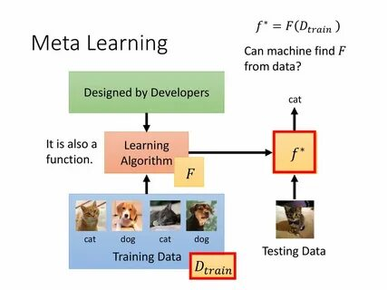
Auto ML and Meta-Learning
Auto ML
Meta-Learning
ES can automate the selection of machine learning models and optimize the data preprocessing.
ES is applied in meta-learning to evolve neural network architectures or learning strategies.

Slide 32
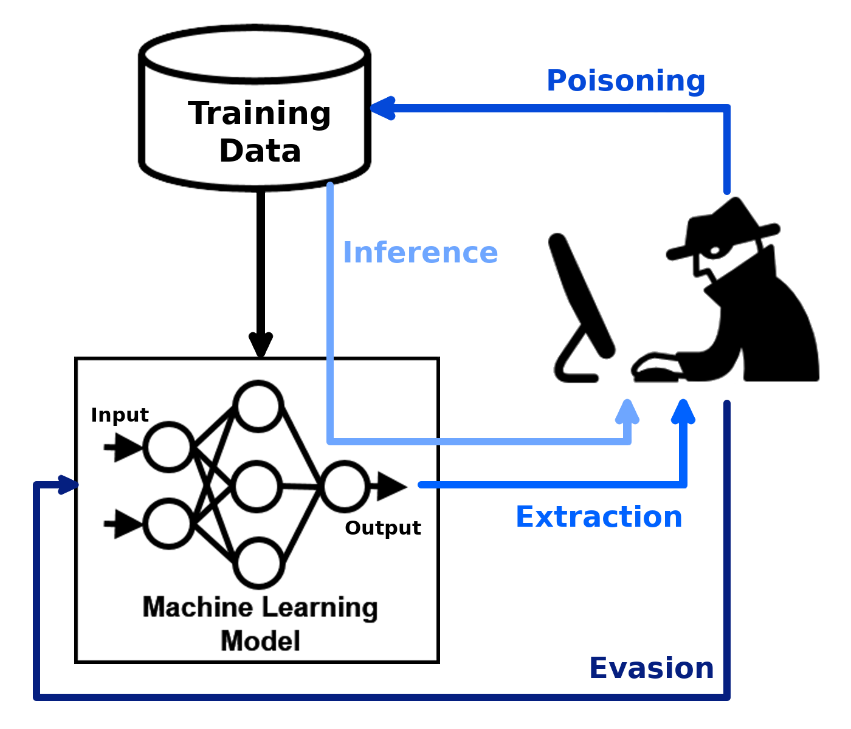
Robustness Testing and Adversarial Learning
Robustness Evaluation: ES can evolve adversarial examples to test the robustness of machine learning models against malicious inputs.
Adversarial Training: ES helps generate diverse adversarial examples, improving model defense mechanisms.

Slide 33
Pros & Cons
7

Slide 34

Advantages of ES
Gradient-Free Optimization
Global Search Capability
Flexibility
Robustness to Noise
Parallelization
Self-Adaptive Parameters

Slide 35

Disadvantages of ES
High Computational Cost
Slower Convergence
Parameter Sensitivity
No Guarantee of Optimality
Reduced Efficiency on Simple Problems
Lack of Interpretability

Slide 36
Real-world cases
8

Slide 37
Real-World Cases
OpenAI
OpenAI used ES (RL) to train AI agents for complex tasks like Atari games and robotic control.
Google
DeepMind has explored ES for optimizing neural network parameters, particularly in reinforcement learning tasks.
Siemens
Siemens applies ES for optimizing manufacturing and logistics operations, such as scheduling, routing, and supply chain problems.

Slide 38
Real-World Cases
Amazon
Amazon employs ES within AutoML systems to optimize machine learning pipelines.
Tesla
Tesla uses ES to generate adversarial examples for testing the robustness of computer vision models.
Nvidia
NVIDIA uses ES for evolving neural network architectures tailored for specific tasks, such as image recognition or gaming AI.

Slide 39

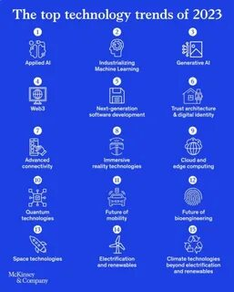
Future trends
9

Slide 40
Future trends
Hybridization with Machine Learning
Enhances optimization for complex, non-linear problems like policy learning and neural network training.
Scalable and Distributed ES
Essential for tackling large-scale challenges in AI, such as training massive neural networks.
Adversarial Testing and Robust AI
Ensures AI systems are safe, secure, and reliable under diverse conditions.

Slide 41
Future trends
Applications in Bioinformatics and Healthcare
Pioneering breakthroughs in personalized medicine and accelerating drug development.
Sustainability and Green Optimization
Addresses global challenges like climate change and energy efficiency.
Self-Adaptive Mechanisms
Improves the algorithm's efficiency and applicability across diverse, evolving optimization problems.

Slide 42


Thanks!
It is time for your questions!

Slide 43
Evolutionary strategies (ES)
Litvinov Andrei 1820249042
Baryshev Maksim 1820249043
Medvedev Ivan 1820249044

